Slide 1
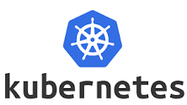
DARSHINI S

Slide 2

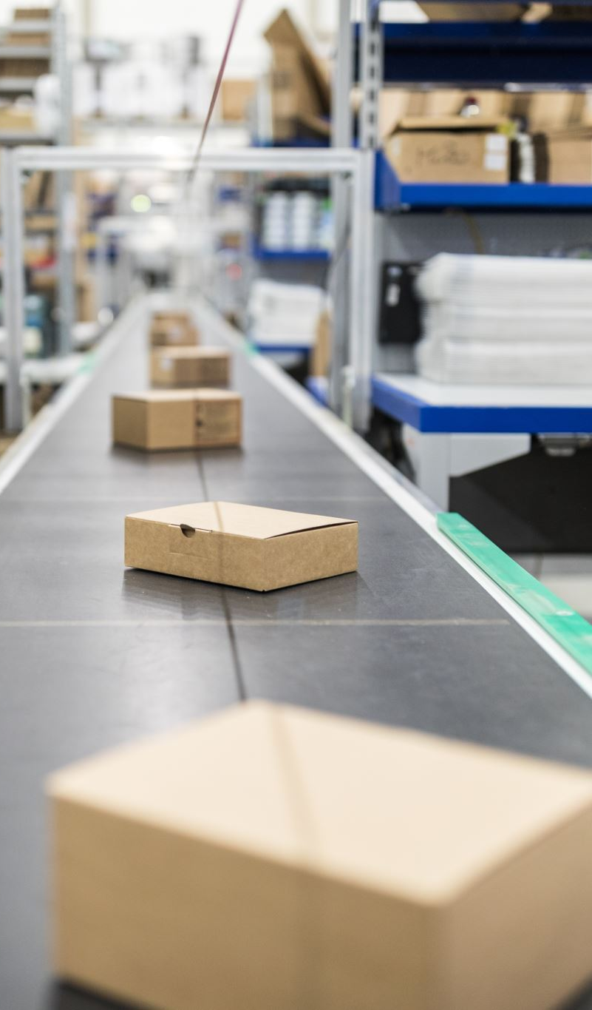
What is kubernetes?
• Kubernetes is an open-source container or container management tool And it take cares the process of • deploying • scheduling • scalling • load balancing
• Kubernetes is also called as k8s.
• google -> cloud native computing foundation(CNCF)
• Kubernetes is written in Golang.

Slide 3
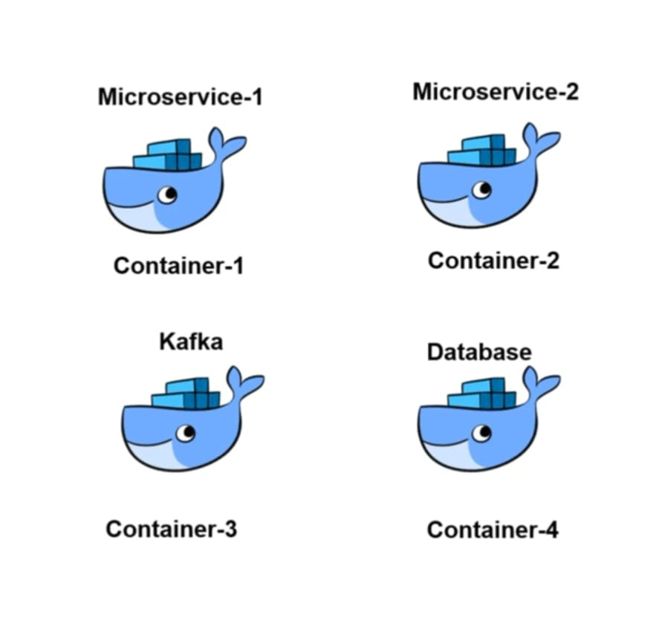
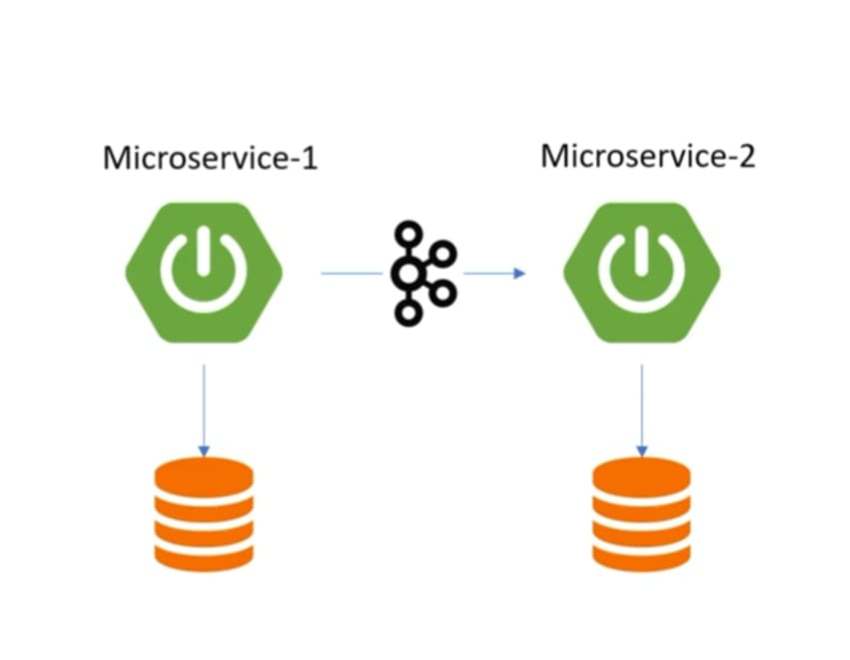
WHY KUBERNETES CAME INTO PICTURE

Slide 4
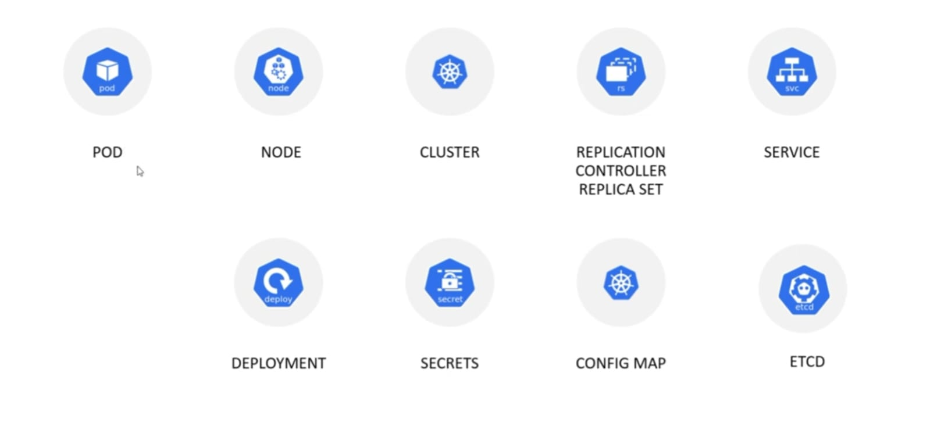
COMPONENTS IN KUBERNETES

Slide 5
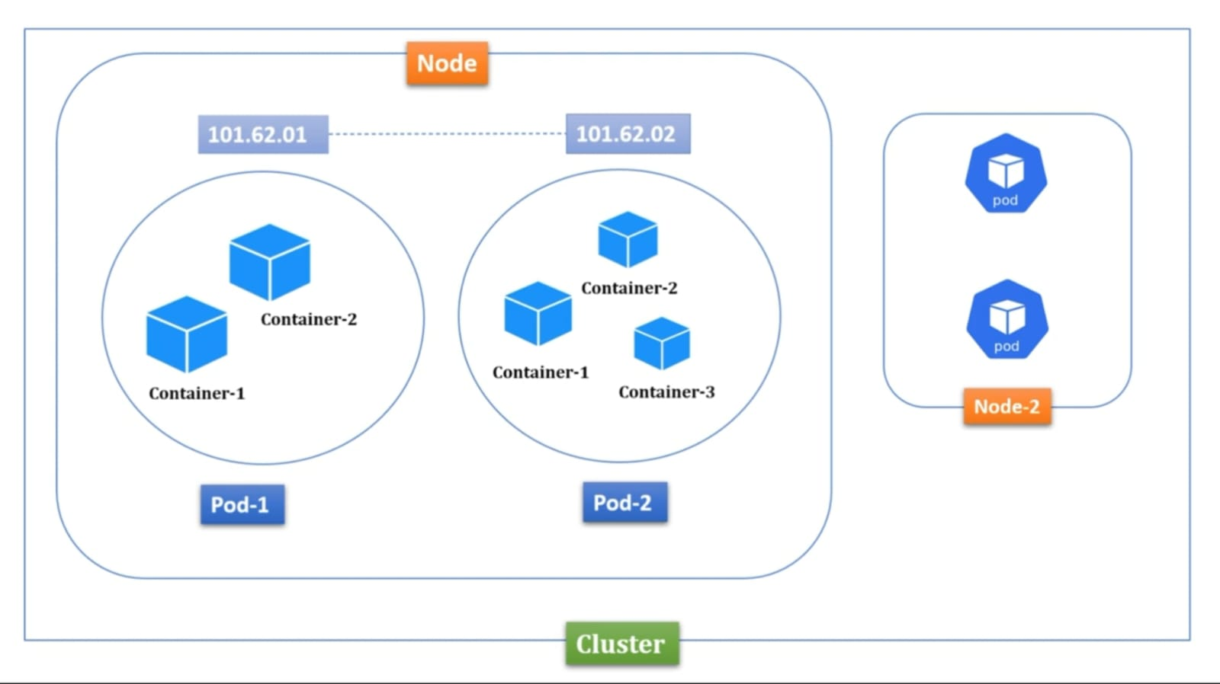
POD NODE AND CLUSTER

Slide 6
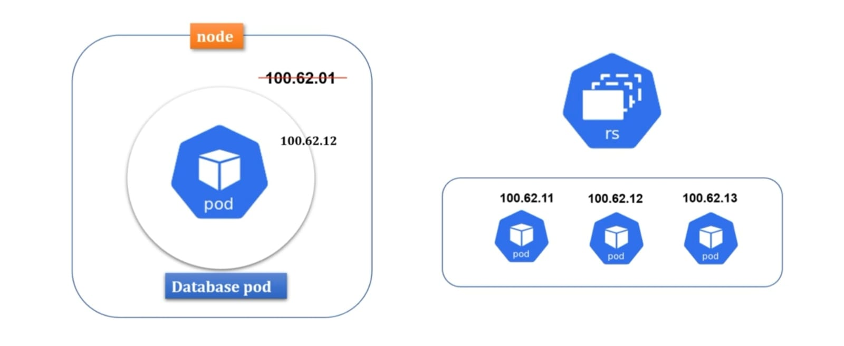
REPLICATION CONTROLLER/REPLICA SETS

Slide 7
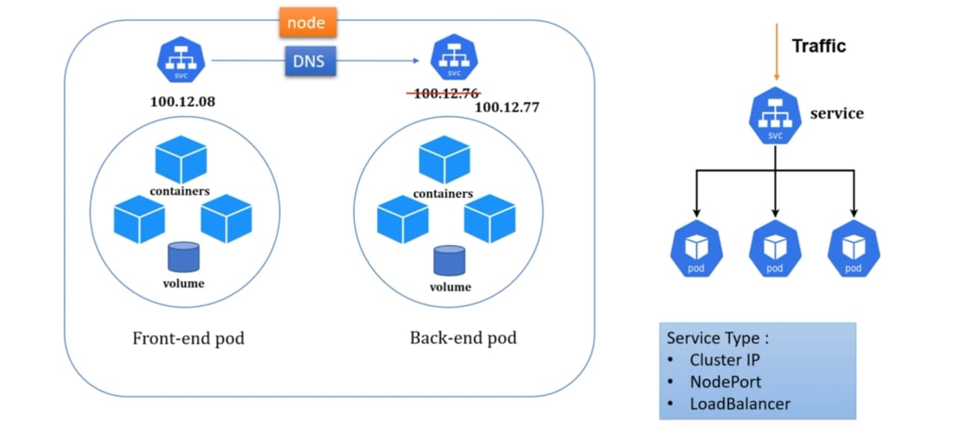
SERVICE

Slide 8
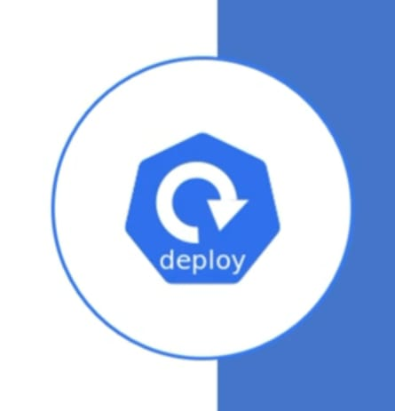
DEPLOYMENT`
• Deployments are Kubernetes objects that are used for managing pods.
• You can scale your application by increasing the number of running pods, or update the running application using deployment objects also configure number of CPU memory everything.

Slide 9
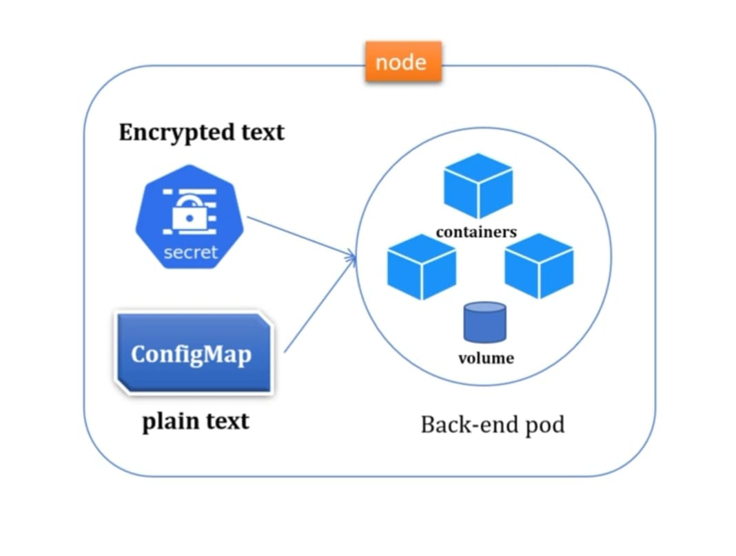
SECRETS AND CONFIG MAP

Slide 10
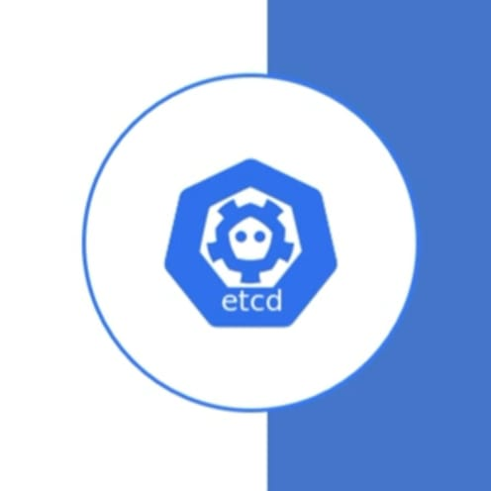
ETCD
• Kubernetes uses etcd as a key-value database store. It stores the configuration of the Kubernetes cluster in etcd.
• It stores all the secret and ConfigMap data inside etcd database.
• Max limit is 1 mb to store secrets.

Slide 11
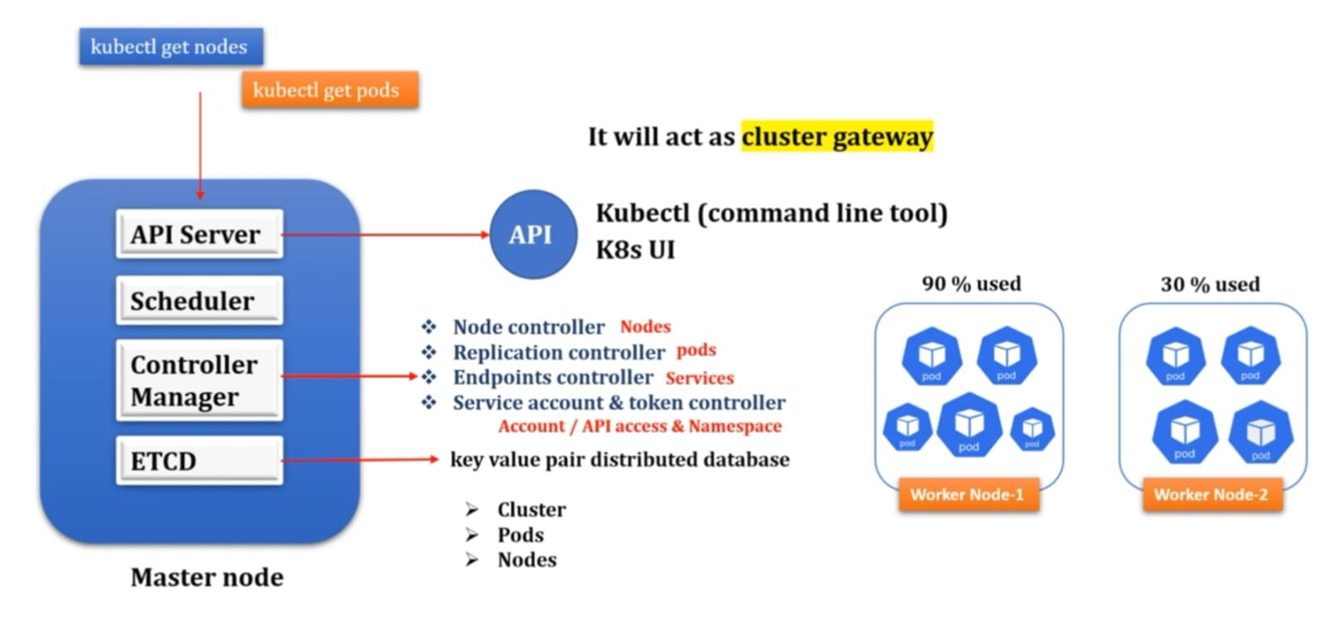
ARCHITECTURE OF KUBERNETES

Slide 12
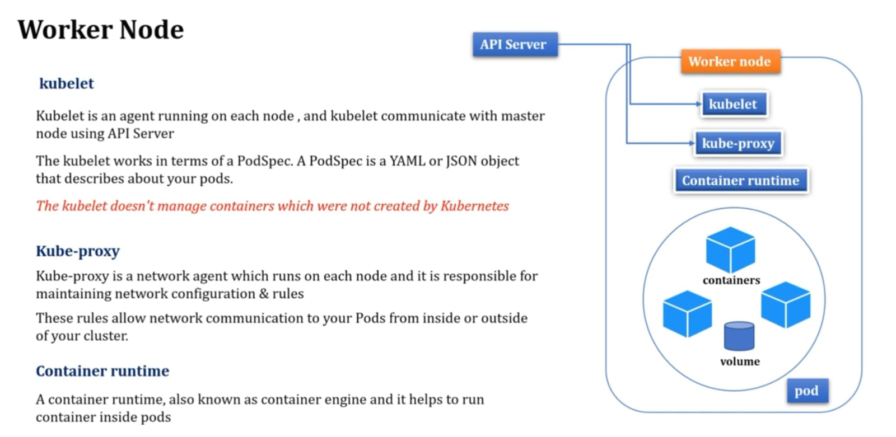
ARCHITECTURE OF KUBERNETES

Slide 13
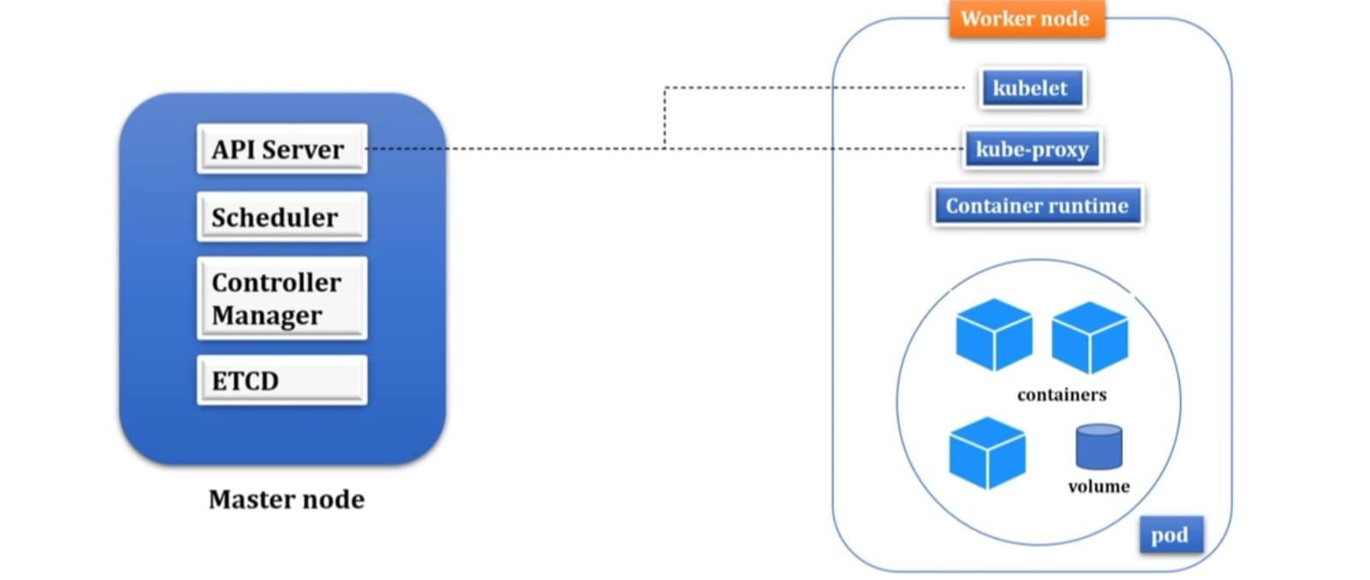
ARCHITECTURE OF KUBERNETES

Slide 14


Thank you

